Slide 1



Charity Law in China
Overview | Charitable Collection | Charitable Trust

Slide 2
Contents
01
02
03
Overview
Charitable Collection
Charitable Trust

Slide 3
Overview
01
National People’s Congress voted through the Charity Law on March 16, 2016
……

Slide 4
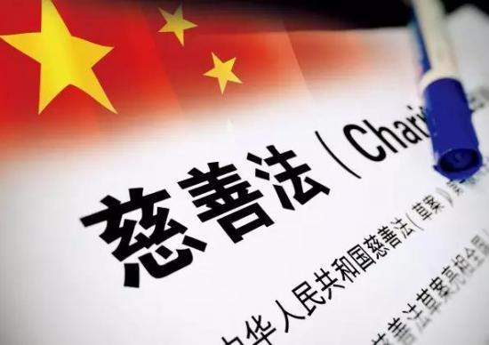
1.Overview
Why does China need a Charity Law？
Reason 1
Reason 2

Slide 5
1.Overview
Reason 1
Charitable Donations in China from 2007-2016

Slide 6
1.Overview
Reason 2
Legislations before Charity Law 2016
Law on Red Cross Society 1993
Regulation on the Administration of the Registration of Social Organizations 1998
Interim Regulations on Registration Administration of Civil Non-enterprise Institutions 1998
Law on Donations for Public Welfare 1999
Trust Law 2001
Regulation on Foundation Administration 2004
Measures for the Administration of Donations for Disaster Relief 2008
Information Disclosure Guidelines for Public-Welfare and Charitable Donations 2011

Slide 7
1.Overview
What is the legislative process of the Charity Law？
National People’s Congress listed the Charity Law into the next five-years legislative plan(2013-2018) in 2013
Ministry of Civil Affair proposed to legislate the Charity Law in 2005
National People’s Congress listed the Charity Law into the five-years legislative plan(2008-2013) in 2008
National People’s Congress voted through the Charity Law on March 16, 2016

Slide 8
1.Overview
The Content of the Charity Law 2016 (China)
Article 1-7 General Rules
Article 8-20 Charitable Organization
Article 21-33 Charitable Collection
Article 34-43 Charitable Donation
Article 44-50 Charitable Trust
Article 51-60 Charitable Property
Article 61-68 Volunteer Service
Article 69-76 Information Disclosure
Article 79-91 Promotion Policy
Article 92-97 Supervision & Administration
Article 98-109 Legal Liability
Article 110-112 Supplementary Articles

Slide 9
Charitable Collection in China: Law, Problems and Reform
02
Dejian LI
Lecturer, Vice-director of Centre of Welfare and Law
Zhejiang University of Technology
PhD (Law School, Shandong University);
PhD (Charity Law & Policy Unit, University of Liverpool)
Email:lidejianlaw@163.com

Slide 10
Definition of Charitable Collections
charitable collections (慈善募捐): activities carried out by charities to collect property on the basis of a charitable purpose.--Charity Law 2016, s 21
non-charitable 'collections' are not regulated by Charity Law 2016:
non-charitable 'collections' are even not allowed to use the term 'collections' in practice
‘individual self-help’(个人自救)/ ‘a person asks others to help himself/herself or his or her family members’(个人求助)

Slide 11
Types of Charitable Collections
public collections (公开募捐):
eg:
setting up donation boxes in public places;
holding charity performances, competitions, bazaars, charity shows, etc.;
publishing collection information through radio, television, newspapers, the Internet, etc.;
and other forms of public collection.
targeted collections （定向募捐）:
definition: collections in a specified scope, such as among initiators, directors and members.

Slide 12
Strict Regulation of Public (Charitable) Collections
public collection certificate (公开募捐资格)
public collections on the Internet (互联网公开募捐)
internet collections information platform （互联网募捐信息平台）
eg：Tencent charity network fundraising platform，Taobao charity platform
collection schemes （募捐方案）and their filing (备案)
disclosure of information （信息公开）
cooperative collection （合作募捐）
verification duty （验证义务）

Slide 13
Problems
non-charitable collections are not sufficiently regulated.
(background: a range of huge crowdfunding platform focusing on relieving individuals are emerging recently).
(eg: by publishing information in the largest disease relief crowdfunding platform, the family members of an actor working in a famous performing company asked the public to donate money so as to relieve this actor. However, it is finally found that the actor was very rich and did not need the help from the public.)
the regulation of charitable collections, especially public charitable collectons, is too strict.
there is a lack of unified regulatory mechanism facilitating the cooperation between the internet collection and the traditional collection carried out by charities.

Slide 14
Reform
enact a unified collections law governing both charitable collections and non-charitable collections
relax the regulation of public charitable collections, such as reducing the conditions and requirements relating to the public collections certificate, and extending the number of internet collections information platforms
strengthen the cooperative regulatory mechanisms governing internet collections and traditional collections to promote the innovative development of collections in China

Slide 15
Charitable Trust
03
Hui Jing
PhD Candidate
Melbourne Law School

Slide 16
Background
Year:
Chinese charitable trust introduced in 2016
Regulator:
civil affairs department at or above the county level
Two Legal Objectives:
giving effect to the settlor’s wishes
promoting charitable undertakings
What is the relationship of the two objectives?
What does the regulatory practice of the charitable trust look like?

Slide 17
Relationship of the Two Objectives
Personal Interest X
Management Method
Selection Criteria
Charitable Undertaking
Settlor’s Wishes
NO Conflict
Article 105 of the Chinese Charity Law
administrative penalties

Slide 18
Practice
Pre-establishment
Negotiation Stage
Post-establishment
Operation Stage
Trusteeship Contract X
Resolution Dispute Clause
Power to Resign

Slide 19
Regulatory Practice
Article 45 of the Chinese Charity Law
Recording
In Practice
Formal Examination ✓
Substantive Examination X
Substantive Examination ✓
Perception of Risks

Slide 20
THANK YOU
Overview | Charitable Collection | Charitable Trust

